Slide 1
Southern Gulf of Saint-Lawrence Snow Crab (Chionoecetes opilio)

Slide 2
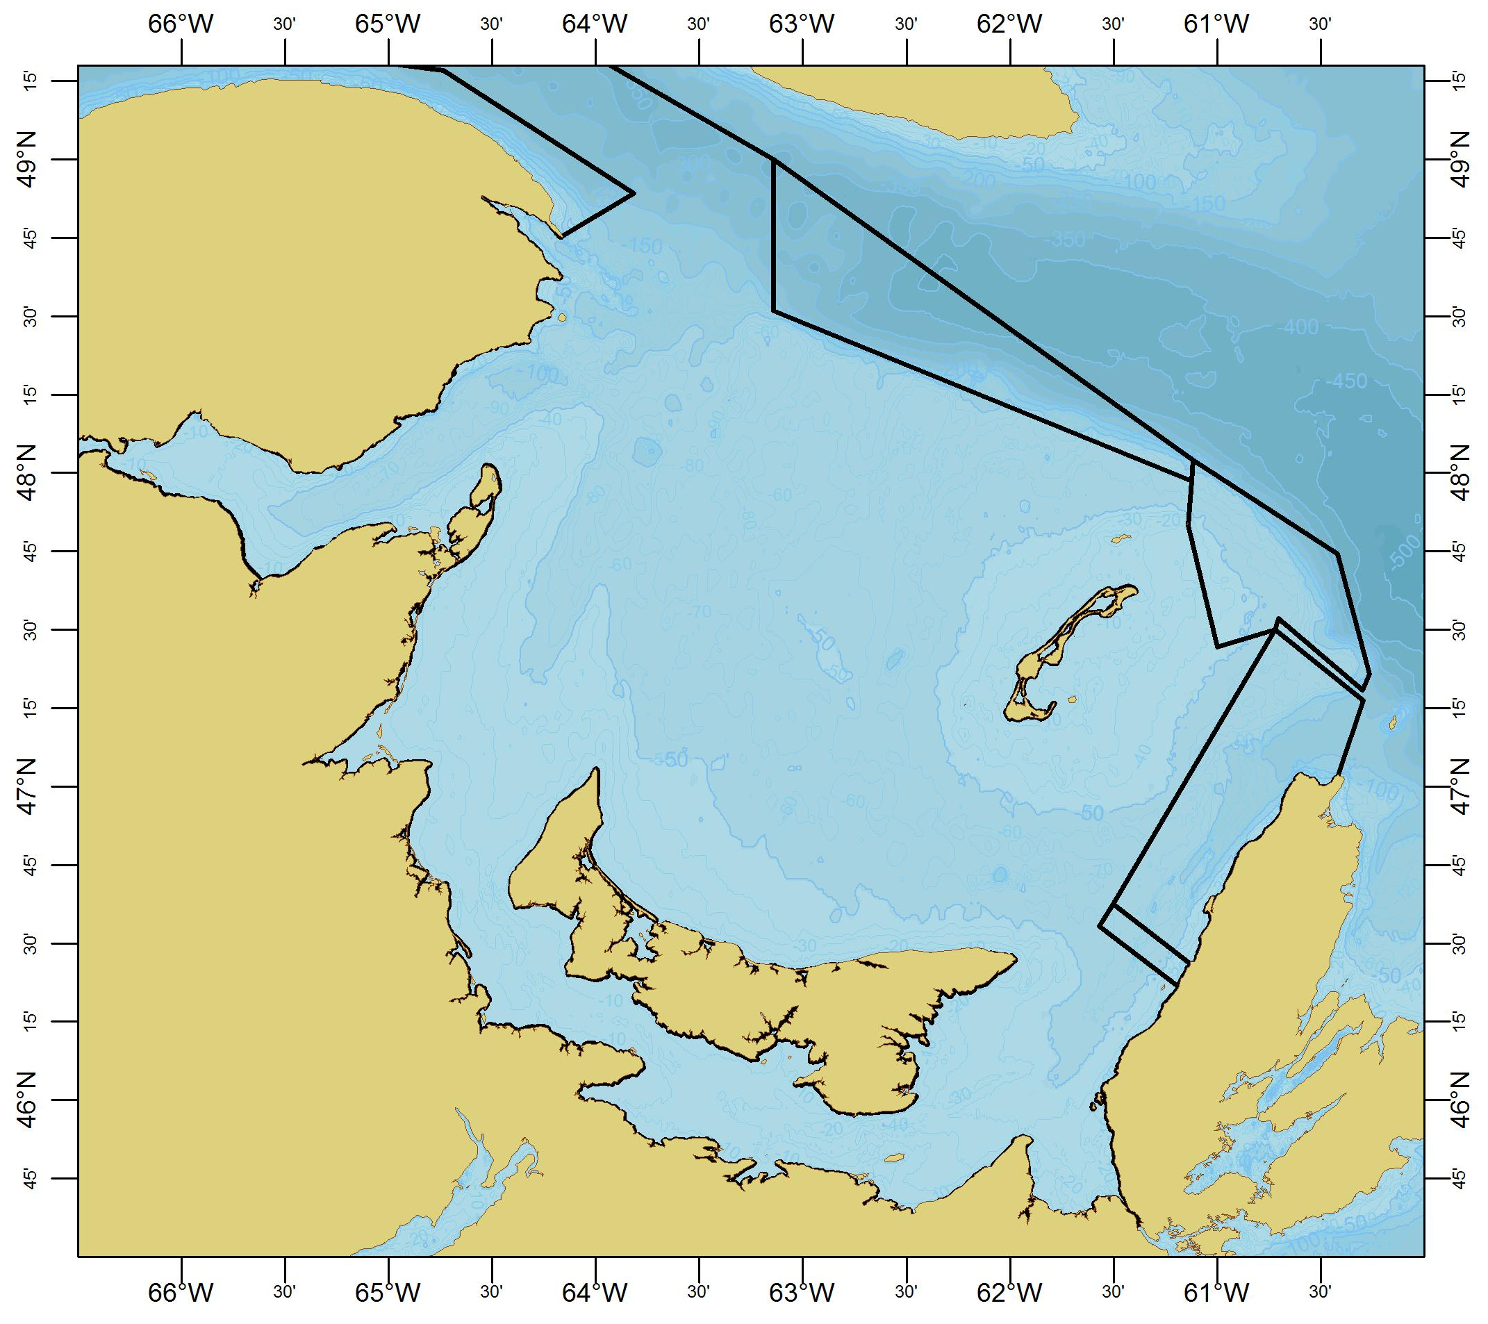
Snow crab harvest control rules:
Input controls:
Snow Fishing Areas 12, 19, 12E, 12F (NB, NS, PEI).
Licences (~ 450).
MLS (95 mm CW), no females.
Trap limits (50-175 12, 5-30 19).
Trap specifications:
6’ to 7’ (max. vol. 2.1 m³).
Escape vents.
Mesh 75mm (side) and 150 mm (stretched).
Vessel length limits (< 65’).
Soft crab (> 20% means closures).
Output controls:
TAC (% survey index).
12E
12
12F
19

Slide 3
Harvest control rule: Exploitation Rate

Slide 4
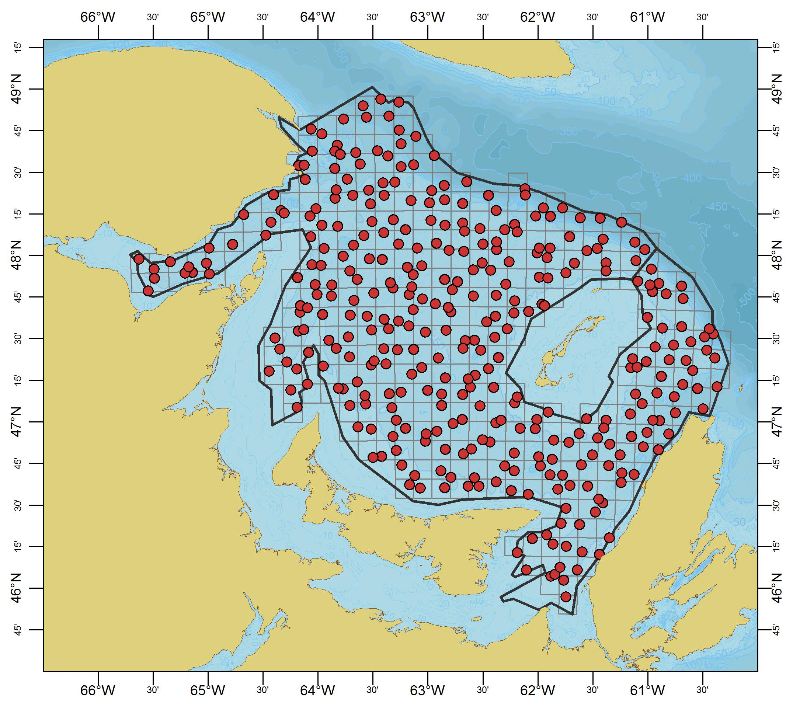
Data sources:
Fishery-dependent
Landings (~1969– present)
At-sea sampling (1982 – present)
Port sampling(~1990 – present)
Logbooks – catch & effort (1984-2018)
Fishery-independent
Snow crab survey (1987-2018).
September RV survey:
1981-2018 catches.
2001-2018 lengths.
Tagging (since mid-1990s).
Fecundity studies (1997-present).

Slide 5
Assessment methodology (annual):
1. Abundance indices:
Fishery-independent: Abundance & biomass (survey) from kriging.
Fishery-dependent; landings and catch-per-unit-effort (logbooks & observer).
2. Risk assessment :
Stage-structured model for predicting fisheries recruitment (survey).
Probability of exceeding reference limits during next fishing season.
3. Fishing pressure indices:
Trends in effort (logbooks & VMS) and trap-soak-days (logbooks).
Proportion of soft crab (observer).
Mean size / size-at-maturity (survey).
4. Production indices:
Instar VIII abundance estimate (survey).
SSB (survey).

Slide 6
Reference points:
Reference period 1997–2010 (survey).
B_{lim} = 10000 t (lowest remaining biomass since 1997)
B_{msy} = 50 % maximum biomass since 1997
B_{usr} = 41400 t (80 % of B_{msy})
F_{lim} =34.6% (average ER)

Slide 7
Ecosystem considerations:
Temperature (monitoring and mapping)
Habitat index (-1 to 3 degrees) (areal index)
Research Priorities/Concerns:
Length-based population model.
Vessel comparison study (2019).
Crab flux between marginal areas.
By-catch is written by observers, but not recorded electronically.
Right whale – crab gear interactions.

Slide 8
Recent assessments:
Hébert, M., Surette, T., Wade, E., Landry, J.-F. and Moriyasu, M. 2018. The 2017 assessment of the snow crab (Chionoecetes opilio) stock in the southern Gulf of St. Lawrence (Areas 12, 19, 12E and 12F) Canadian Science Advisory Secretariat (CSAS) Research Document 2018/046. http://waves-vagues.dfo-mpo.gc.ca/Library/40722843.pdf
DFO. 2018 Assessment of snow crab(Chionoecetes opilio) in the southern Gulf of St. Lawrence (Areas 12, 19, 12E and 12F) ro 2017 and advice for the 2018 fishery. DFO Can. Sci. Advis. Sec. Sci. Resp. 2018/007.

